Slide 1
Challenges of deep learning in medical image analysis – improving explainability and trust
Constantin Ana-Maria

Slide 2
Table of contents
01
04
02
03
05
Introduction
Ethical Principles, Opportunities and Future Research Directions
Deep Learning in Healthcare
Conclusion
Challenges of Deep Learning in Healthcare

Slide 3
Introduction
Deep Learning (DL) in medical image analysis: Precision and automation for diagnoses.
Transformative applications in CAD systems with minimal human supervision.

Slide 4
Deep Learning in Healthcare
Applications:
Biological image processing.
Illness diagnosis.
Surgical system design.
Key Statistics:
58% of patients familiar with AI in healthcare.
52% trust AI for medical needs.
CAD systems: Continuous retraining and field testing to enhance reliability and trust.

Slide 5
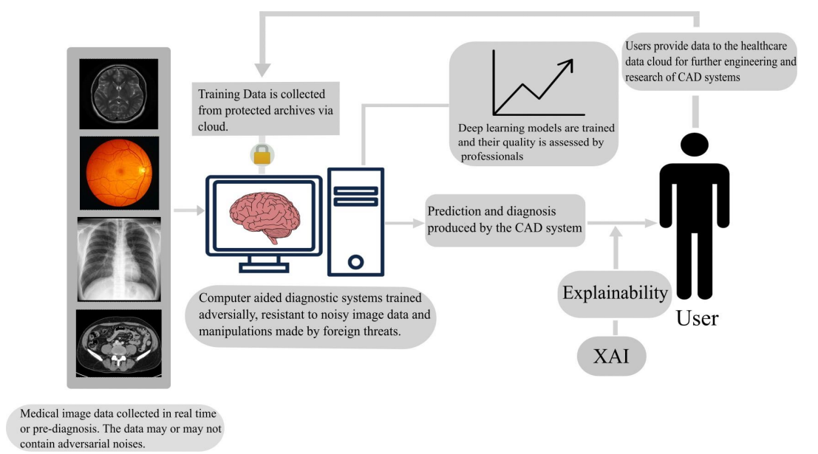

Slide 6
Challenges of Deep Learning in Healthcare

Slide 7
Adversarial Attacks
Noise and artifacts in medical images cause misclassifications:
MRI: Motion artifacts.
CT: Scatter and beam-hardening artifacts.
X-rays: Speckle, Poisson, and Gaussian noise.
Countermeasures:
Adversarial training.
Generative Adversarial Networks (GANs).

Slide 8
Unavailability and Imbalanced Data
Unavailability: Annotated datasets are expensive and time-consuming to create.
Imbalance: Leads to biased models.
Solutions:
Data augmentation: Traditional (flipping, rotation) and GAN-based methods.
GANs like Pix2pix and StyleGAN 2 enhance dataset diversity.
Challenges: Trust in synthetic data remains low.

Slide 9
Trust Issues and Explainability in AI for Healthcare
DL criticized as a "black box" – undermines confidence in critical applications.
Explainable AI (XAI) techniques:
Model-agnostic: SHAP, LIME (e.g., Parkinson's disease prediction).
Model-specific: Grad-CAM, heatmaps (e.g., COVID-19 diagnosis).
Post-hoc: Analyzing trained models to uncover patterns.

Slide 10
Privacy and Legal Issues of Medical Data
Sensitive nature of medical data: Risks of cyberattacks and misuse.
Regulatory frameworks: HIPAA (USA), GDPR (EU), and Germany’s PDSG.
Mitigations:
Pseudonymized data and differential privacy.
Privacy audits for secure handling.

Slide 11
Ethical Principles
Governance practices:
Stakeholder communication.
Cross-functional collaboration.
Continuous updates (MLOps).
Core principles:
Transparency and fairness.
Non-maleficence (avoiding harm).
Accountability.

Slide 12
Opportunities for DL in Healthcare
Patient-specific care: Tailored treatments and diagnoses.
Disease forecasting: Predict progression with longitudinal data.
Surgical planning: Real-time guidance for surgeons.
Rural healthcare access: Bridging gaps in underdeveloped areas.

Slide 13
Future Directions
Quantitative assessments: Include global demographics.
AI governance: Integrate IT, data, and AI policies.
Standardization: Benchmarks for explainability and privacy.

Slide 14
Best Practices for Responsible AI
Share tools and resources with the community.
Update systems with real-time feedback.
Perform rigorous testing across datasets.
Balance simplicity and performance in design.

Slide 15
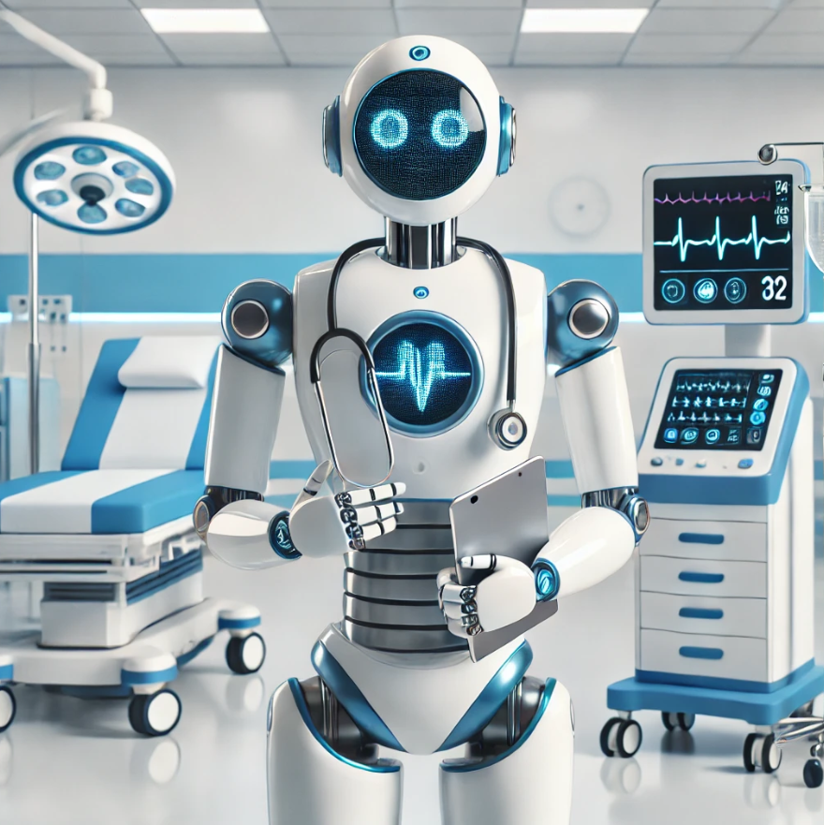
Conclusion
Potential: Revolutionizing healthcare through AI-driven systems.
Key goals: Ethical design, improved transparency, and trust.
Impact: Bridging the gap between technology and society for better healthcare outcomes.

